Slide 1
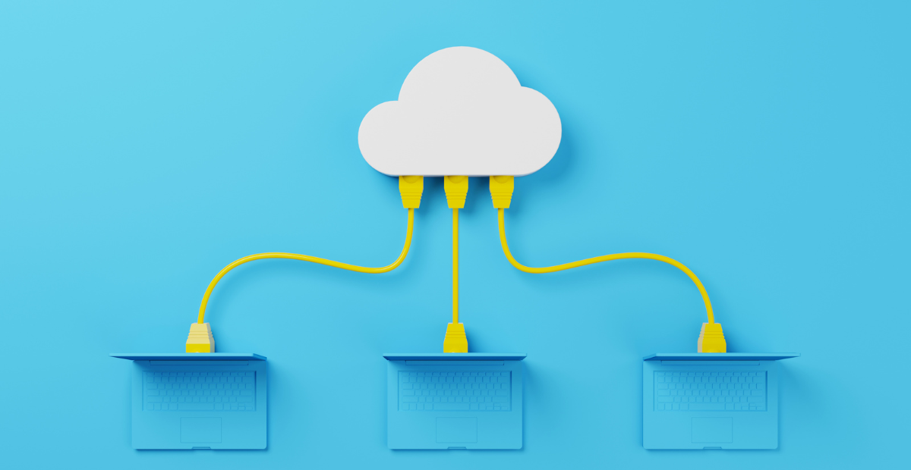
Case-Study Group 13
Mihai Glodici
Jorn Kosterman
Soufiane El Atmani

Slide 2

Agenda
Our network
Problems we are working on
Progress since last time
Challenges
Future plans
Demo
MDP
Personal reflection

Slide 3
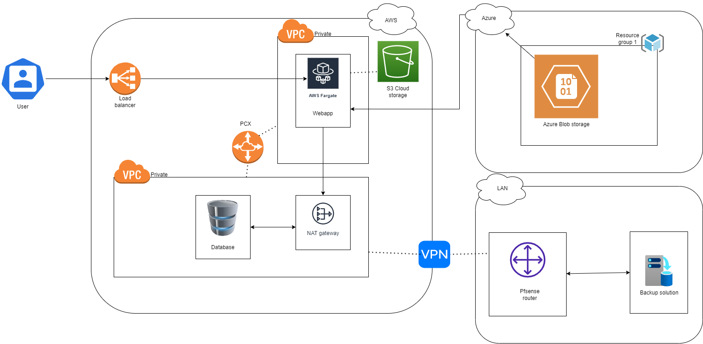
Our network (with demo)

Slide 4

Problems we are working on
Connecting azure blob to our web-app
Setting up a back-up solution (RDS-DataSync)
Automating network setup(CloudFormation/Terraform)
Monitoring solution
Updating documentation

Slide 5

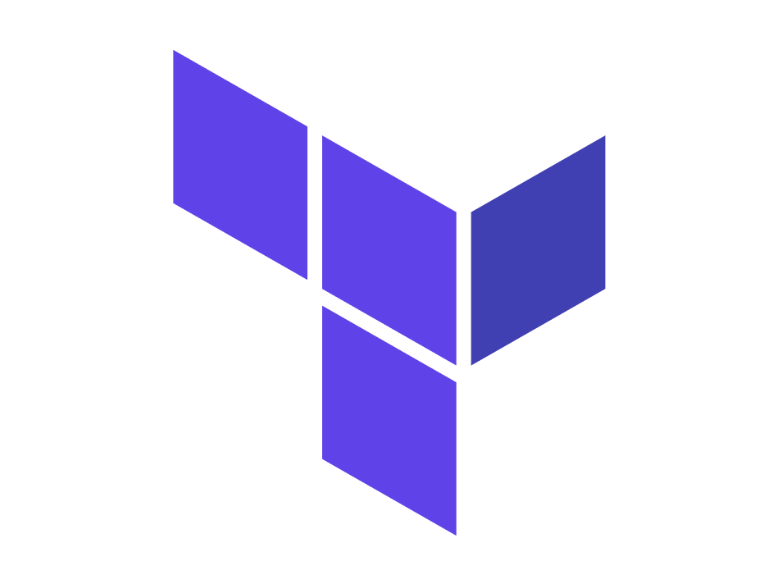
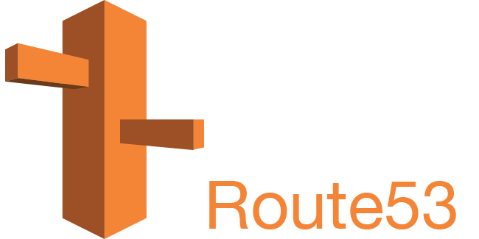
Progress since last time
Managed to dockerize webapp + nginx in one container
Setup vpn connection to azure
Second version of terraform script
Route53 implementation
Azure environment is ready

Slide 6



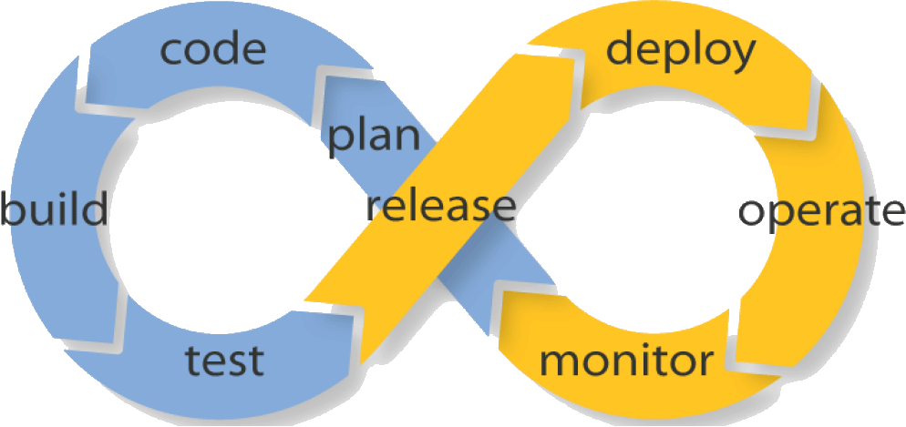
Future plans
Prometheus monitoring server
Grafana dashbord (For prometheus)
Step-functions
CI/CD pipeline
Automating Azure infrastructure

Slide 7
Challenges
Dockerizing webapp + nginx
Unfamiliarity with automating infrastructure
Unfamiliarity with Azure

Slide 8
Demo
Terraform initialize and destruct
Azure:
Resource group
Site-to-site vpn (to aws)
Blob storage

Slide 9

MDP
USPC
No existing infrastructure
better their data management

Slide 10
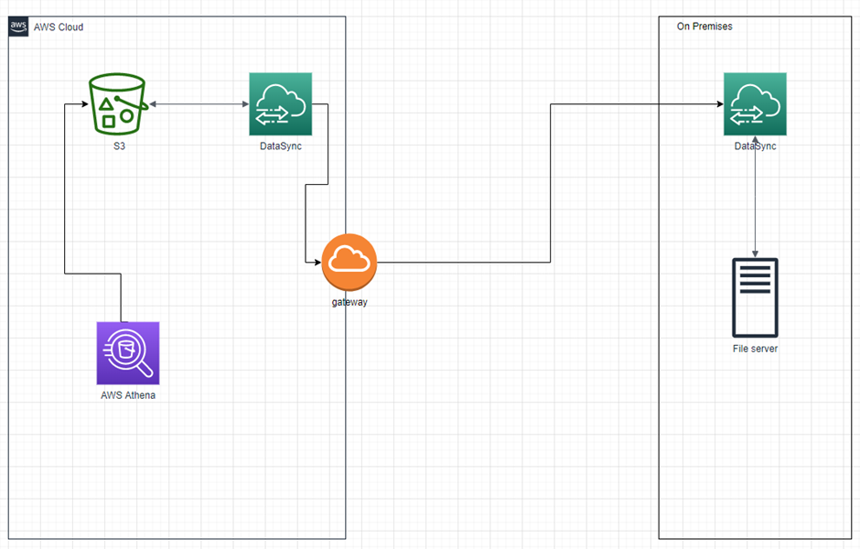
MDP
USPC
Completed:
Hybrid data storage solution
Athena Sql querries
DataSync for syncronizing storage
Working on:
Webapp file transfer

Slide 11
Personal reflection
Mihai
Automation experience
Various AWS services(DataSync,Athena,route53)
Jorn
Much progress
Still a few things to acomplish
Soufiane
A nice experience using azure

Slide 12

The End
Questions?

